Slide 1
SWE3999 - Technical Answers to Real World Problems (TARP)
Project Title - DESKTOP VOICE ASSISTANT(JARVIS)

Slide 2
Abstract:
As we know Python is an emerging language so it becomes easy to write a script for Voice Assistant in Python. The instructions for the assistant can be handled as per the requirement of user. Speech recognition is the process of converting speech into text.
This is commonly used in voice assistants like Alexa, Siri, etc. In Python there is an API called Speech Recognition which allows us to convert speech into text.
It was an interesting task to make my own assistant. It became easier to send emails without typing any word, Searching on Google without opening the browser, and performing many other daily tasks like playing music, opening your favorite IDE with the help of a single voice command.
In the current scenario, advancement in technologies are such that they can perform any task with same effectiveness or can say more effectively than us. By making this project, I realized that the concept of AI in every field is decreasing human effort and saving time
Now the basic question arises in mind that how it is an AI? The virtual assistant that I have created is like if it is not an A.I, but it is the output of a bundle of the statement. But fundamentally, the mail purpose of A.I machines is that it can perform human tasks with the same efficiency or even more efficiently than humans. It is a fact that my virtual assistant is not a very good example of A.I., but it is an A.I.

Slide 3
Introduction:
Artificial Intelligence when used with machines, it shows us the capability of thinking like humans. In this, a computer system is designed in such a way that typically requires interaction from human. As we know Python is an emerging language so it becomes easy to write a script for Voice Assistant in Python. The instructions for the assistant can be handled as per the requirement of user. Speech recognition is the Alexa, Siri, etc.
In Python there is an API called Speech Recognition which allows us to convert speech into text. It was an interesting task to make my own assistant. It became easier to send emails without typing any word, Searching on Google without opening the browser, and performing many other daily tasks like playing music, opening your favorite IDE with the help of a single voice command.
In the current scenario, advancement in technologies are such that they can perform any task with same effectiveness or can say more effectively than us. By making this project, I realized that the concept of AI in every field is decreasing human effort and saving time

Slide 4
Problem statement
We are familiar with many existing voice assistants like Alexa, Siri, Google Assistant, Cortana which uses concept of language processing, and voice recognition. They listens the command given by the user as per their requirements and performs that specific function in a very efficient and effective manner.
As these voice assistants are using Artificial Intelligence hence the result that they are providing are highly accurate and efficient. These assistants can help to reduce human effort and consumes time while performing any task, they removed the concept of typing completely and behave as another individual to whom we are talking and asking to perform task.
These assistants are no less than a human assistant but we can say that they are more effective and efficient to perform any task. The algorithm used to make these assistant focuses on the time complexities and reduces time.

Slide 5
Motivation
The main goal is to improve the efficiency of the personalassistant application by giving the agent the ability tolearn.
Because the agent typically performs a large numberof repetitive activities, previous experiences can beapplied to similar future scenarios.
We propose a learn-bydoing agent that will aid the user in completing tasks. Thetask at hand is to manage the user's desktop or laptopprofile. Every user has a daily schedule that requires themto place their desktop or laptop at a distance for a periodof time.

Slide 6
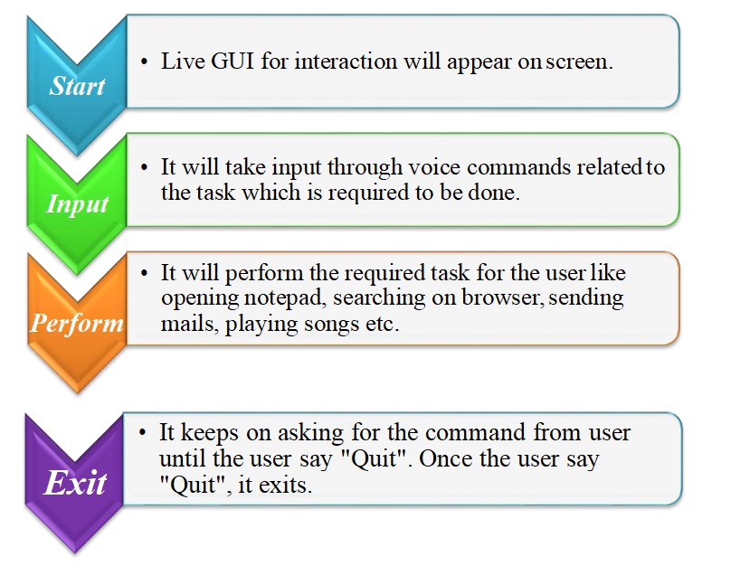
Data flow diagram

Slide 7
Comparing ours assistant and iphone(siri)
jarvis
siri
It can open camera
It can play songs
It can open apps
It makes reminders
It tellsweather
It is having a separate ui
It cannot make calls
It cannot open camera
It cannot play songs
It can open apps(not all)
It can add reminders and make notes
It does not have a ui
It makes calls

Slide 8
Features(additional)
It opens notepad
It can save screenshots
It can play music
It can say about system stats
It can increase decrease mute volumes
It can switch tabs
It can send messages
It can say weather info
It can say our location

Slide 9
Requirements
Laptop
Windows(7 or above)
Python (3.7above)
Visual studio
Pyqt5 designer
Microphone,speaker

Slide 10
Modules used
sys
Random
Pyqt5
Datetime module
Os
Pyttsx3
Jokes
Pyautogui
Pypdf2
Psutil
Instaloader
Wikepedia
Smtplib
Opencv
Speech recognisation

Slide 11
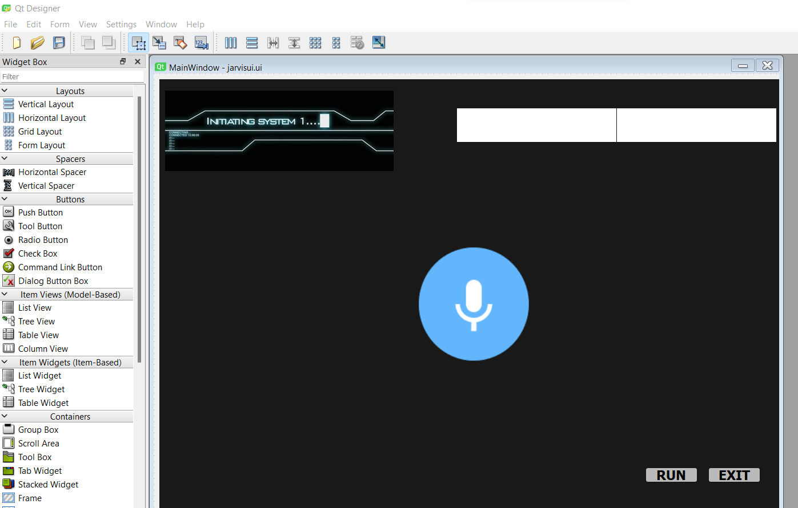
USER INTERFACE

Slide 12
Team Members
K Vishnu Vardhan-18MIS1098
S Ruthvik-18MIS1048
P Guru Pavan Kumar-18MIS1062
N Bhanu Prakash-18MIS1057
Devadathan B -17MIS1105

Slide 13
Thank You

